Slide 1
Introduction to Computer Vision
Lecture 04 - Linearity and Convolution
Dr. Abdul Basit
Associate Professor - CS & IT University of Balochistan
June 17, 2026
Linearity and Convolution

Slide 2




Contents
1
Filtering an image
2
Correlation vs Convolution Correlation
Convolution
3
Boundary problems
4
Linear filters
Linearity and Convolution

Slide 3
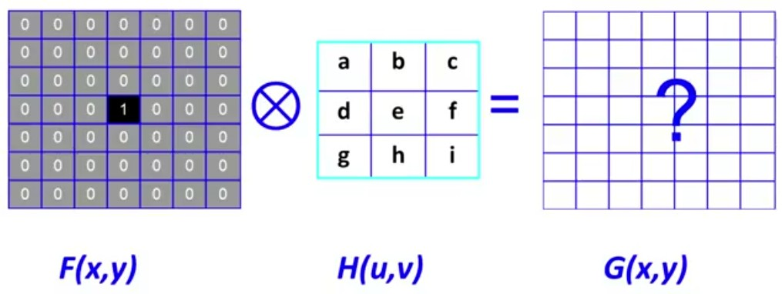
Convolution
Filtering an image
Linearity and Convolution

Slide 4
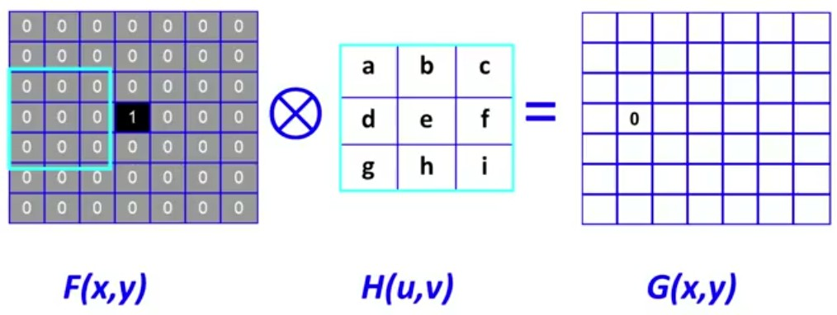
Convolution
Filtering an image
Linearity and Convolution

Slide 5
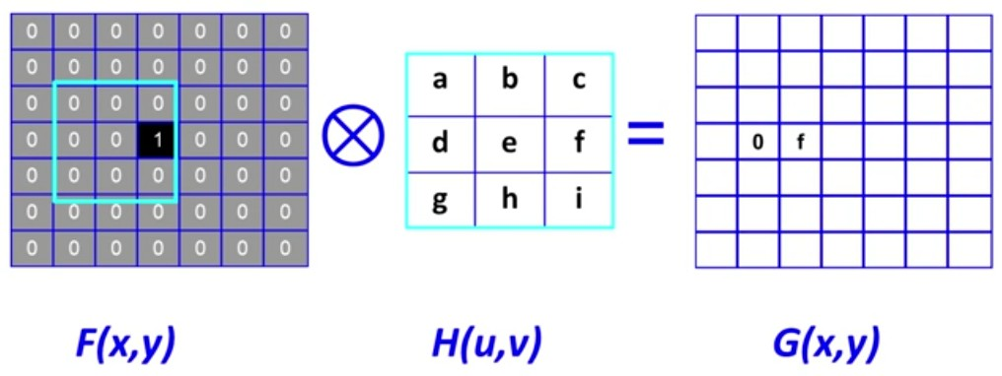
Convolution
Filtering an image
Linearity and Convolution

Slide 6
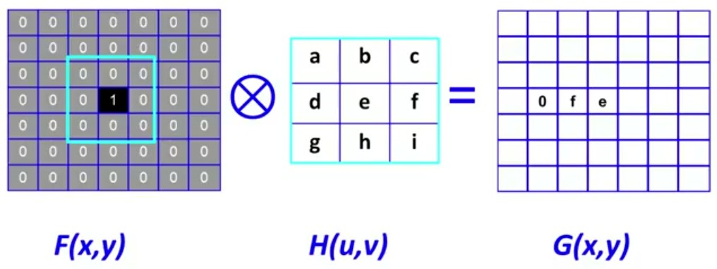
Convolution
Filtering an image
Linearity and Convolution

Slide 7
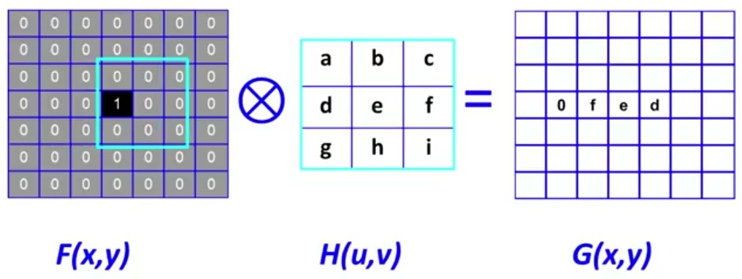
Convolution
Filtering an image
Linearity and Convolution

Slide 8
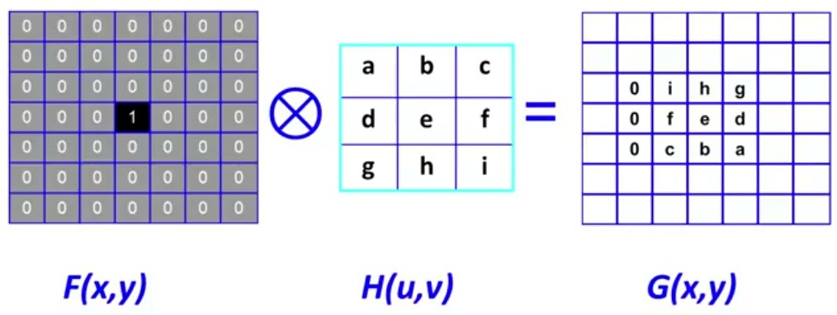
Convolution
Filtering an image
Linearity and Convolution

Slide 9


Contents
1
Filtering an image
2
Correlation vs Convolution Correlation
Convolution
3
Boundary problems
4
Linear filters
Linearity and Convolution
9 / 26

Slide 10
Contents
1
Filtering an image
2
Correlation vs Convolution Correlation
Convolution
3
Boundary problems
4
Linear filters
Linearity and Convolution
9 / 26

Slide 11
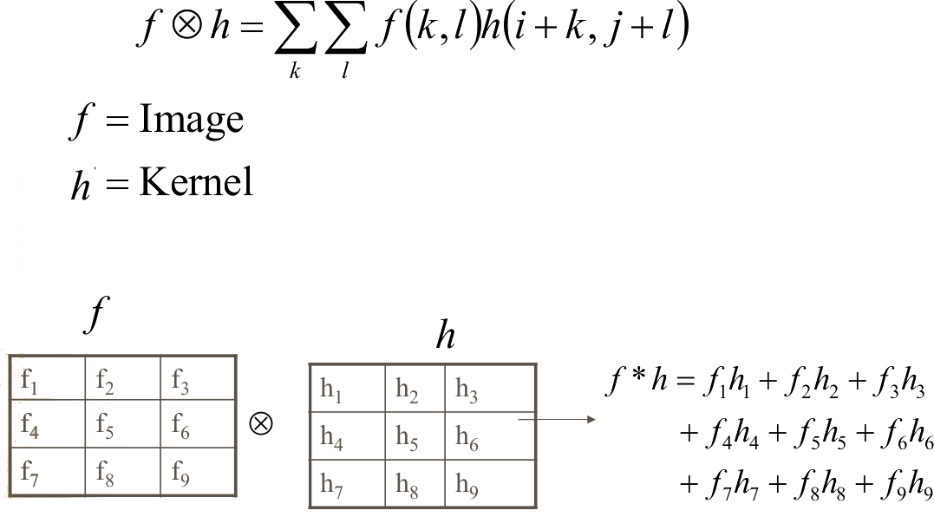
Correlation vs Convolution
Correlation
Linearity and Convolution

Slide 12
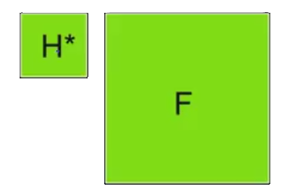
Correlation vs Convolution
Correlation
1D correlation.
N
Σ
k=−N
H ⊗ F(i ) =
H(k)F(i + k)
2D correlation.
n n
Σ Σ
G(i, j) =
H[k, l ]F(i + k, j + l )
k=−n l=−n
G = F ⊗ H
Figure: A SUGV as a pursuit robo
.t
Linearity and Convolution
11 / 26

Slide 13
Contents
1
Filtering an image
2
Correlation vs Convolution Correlation
Convolution
3
Boundary problems
4
Linear filters
Linearity and Convolution
11 / 26

Slide 14
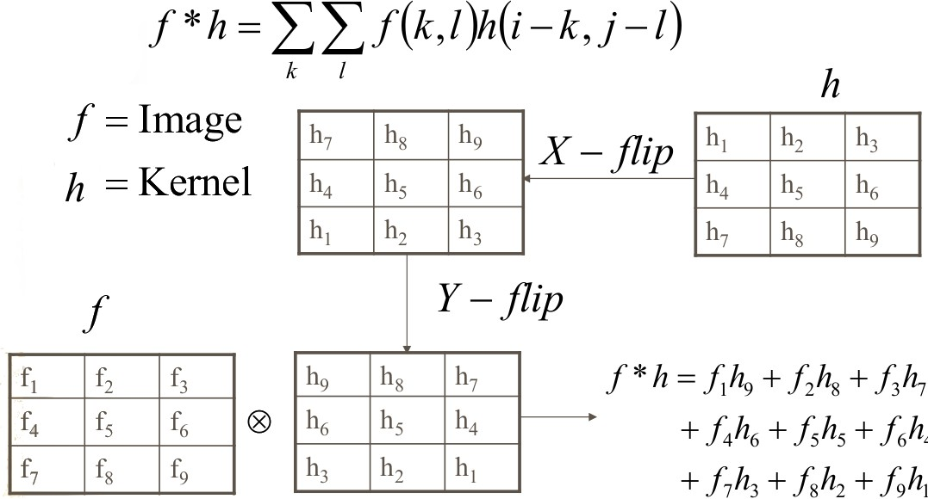
Correlation vs Convolution
Convolution
Linearity and Convolution

Slide 15
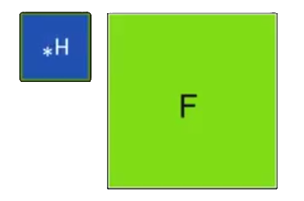
Correlation vs Convolution
Convolution
1D convolution.
N
Σ
k=−N
H ∗ F(i ) =
H(k)F(i − k)
2D convolution.
n n
Σ Σ
G(i, j) =
H[k, l ]F(i − k, j − l )
k=−n l=−n
G = F ∗ H
Figure: Notation for a Convolution. Source: K. Grauman
Linearity and Convolution

Slide 16

Contents
1
Filtering an image
2
Correlation vs Convolution Correlation
Convolution
3
Boundary problems
4
Linear filters
Linearity and Convolution

Slide 17
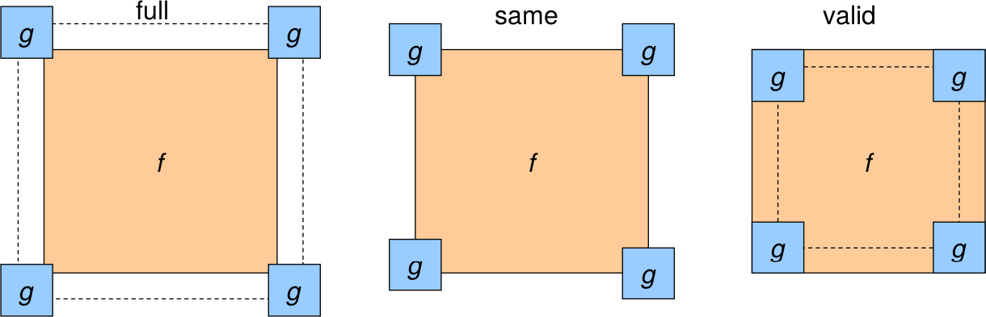
Boundary problems
Size of the output?
What is the size of the output image? The shape is
full: Output size is of sizes of f and g
same: Output size is same of f
valid: Output size is difference of sizes of f and g
Figure: Boundary problems. Source: S. Lazebnik
Linearity and Convolution

Slide 18

Boundary problems
Size of the output?
clip filter (black)
Linearity and Convolution

Slide 19

Boundary problems
Size of the output?
clip filter (black)
Linearity and Convolution

Slide 20

Contents
1
Filtering an image
2
Correlation vs Convolution Correlation
Convolution
3
Boundary problems
4
Linear filters
Linearity and Convolution

Slide 21
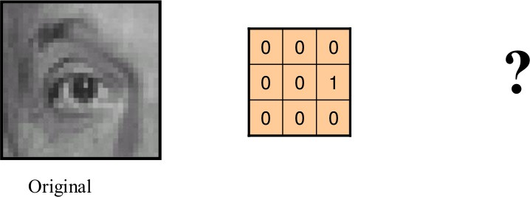
Linear Filters
Linearity and Convolution

Slide 22
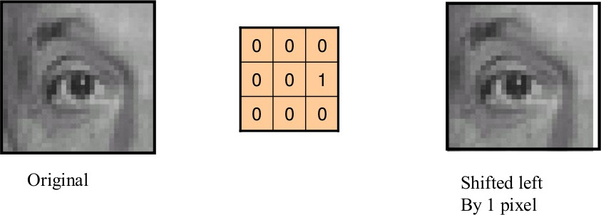
Linear Filters
Filter with no change.
Linearity and Convolution

Slide 23
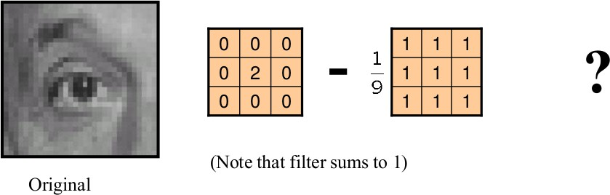
Linear Filters
Linearity and Convolution

Slide 24
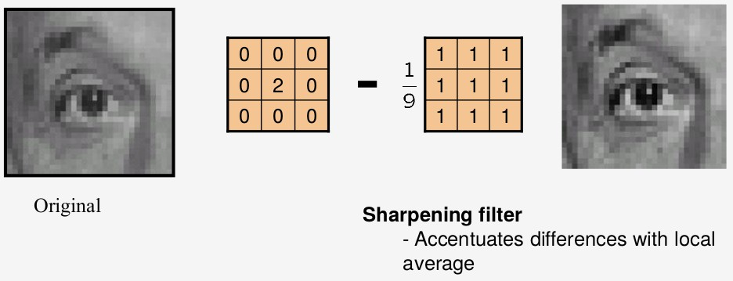
Linear Filters
Filter with no change.
Linearity and Convolution

Slide 25
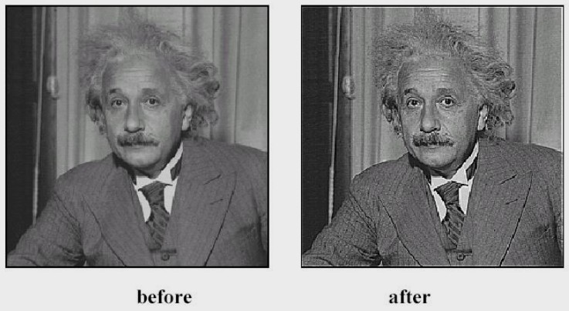
Linear Filters
Filter with no change.
Linearity and Convolution

Slide 26
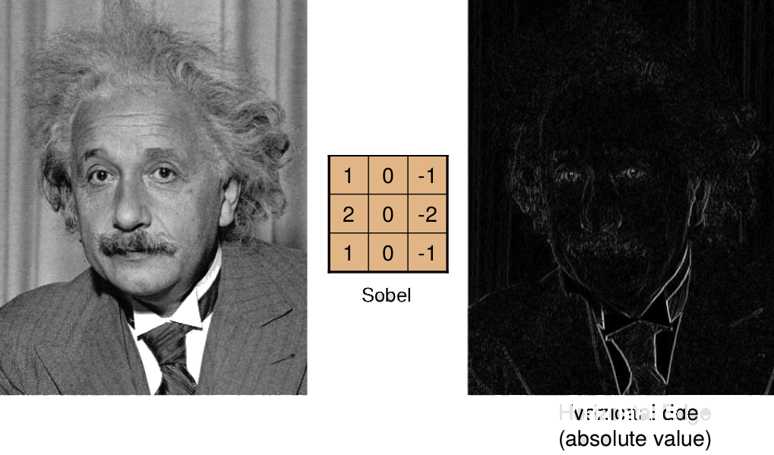
Linear Filters
Filter with no change.
Linearity and Convolution

Slide 27
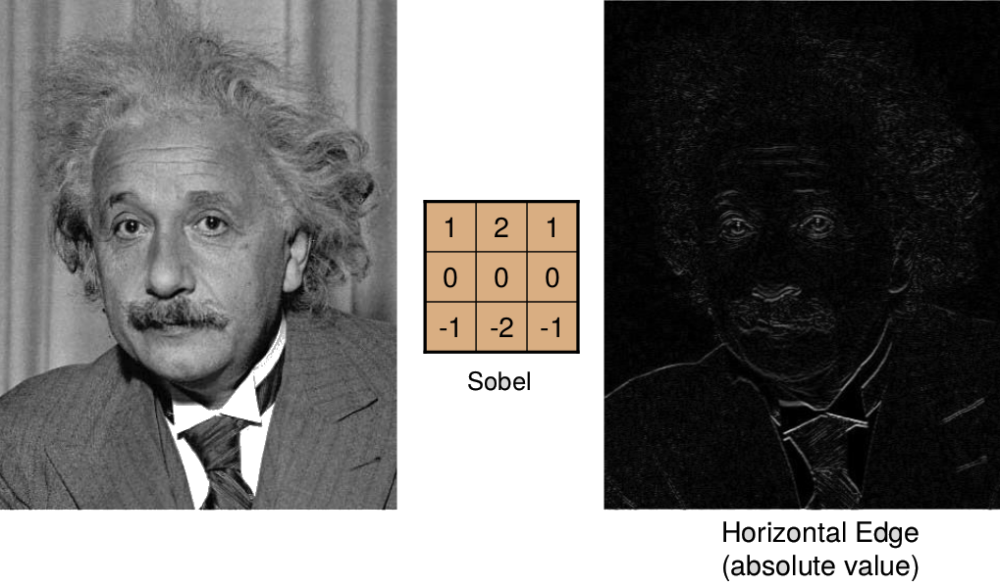
Linear Filters
Filter with no change.
Linearity and Convolution

Slide 28
The End
28 / 28

